Slide 1
Jacob Summer Update V
Optimization

Slide 2
Objective
Determine optimal moment arm & motor combination for largest jump height*
*(final height)-(starting height)

Slide 3
Simulation Comparison
MATLAB now accounts for changing angle
MATLAB predicts higher jump height
And faster optimized configuration
2 differences
Leg has inertia only in Unity
Leg leaves the ground before fully extending in Unity, whereas in MATLAB applies force until fully extended
Notes:
Stop matlab sim at angle
.18571

Slide 4
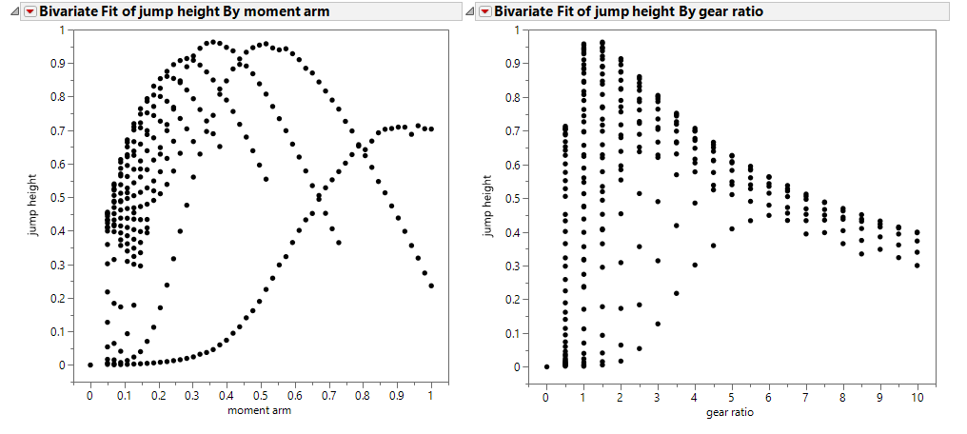
Sim with Changing Mass
Mass = motors + volume_of_leg * density

Slide 5
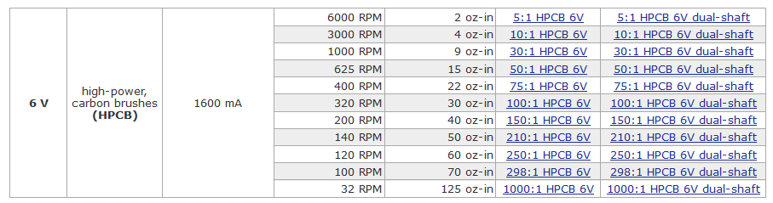
Motor

Slide 6
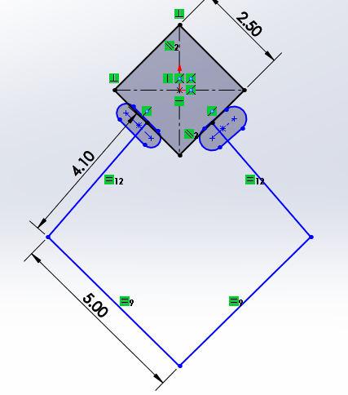
Device

